Slide 1
Community-Based Co-Supervisory Community Health Worker Model
Jean M. Gunderson, DNP, RN Success with CHWs: Models, Evidence and Resources
December 1, 2015

Slide 2
Objectives
Describe the building of teams integrating CHWs in a certified Health Care Home
Review examples of CHWs working with patients diagnosed with diabetes and/or hypertension
Describe nonmedical determinants of health contexts within relational care
Examine the community based co-supervisory CHW model

Slide 3
CHW Pilot: Co-creating Transdisciplinary Team Based Care
Internship and Pilot co-created with lead Care Coordinators and leaders in Mayo Clinic Employee and Community Health (ECH)
Specific service areas: Primary Care Internal Medicine (PCIM), Integrated Behavioral Health (IBH) and Community Pediatric & Adolescent Medicine (CPAM)
Referral Criteria: complex care needs, eligible for or enrolled in care coordination , with significant non-medical health determinants
Expanded programming: Family Medicine (FAM), DIAMOND, EMERALD, COMPASS, Care Transitions/Palliative Care Homebound Program, Social Work, and EPSDT (C&TC) complex care needs

Slide 4
Extensions of Collaborative Care Management (Patient Reporting & CHW Inquiry)
Monitor symptoms
Monitor medications
Engage in goal setting
Provide educational support
Refer to wellness resources
Relapse prevention
Self-management; Strength-based support
Resiliency
Telephonic support
Continuum of Care

Slide 5
The Alignment of the CHWS to the PATIENT EXPERIENCE
Community based co-supervisory CHW model
Order by Proxy options (Primary Care orientation)
Team huddles, patient conferences and consults
Telephonic support
Patient home visits and at other community based sites
Non Visit Care coordination supports
Guardian of the Patient Narrative

Slide 6
The Patient Narrative: One Home Visit
Team referral for diabetes care follow-up
Patient request for homecare services; referral initiated
Patient complaint of hip pain; appointment follow-up for potential surgery
Review and teaching: Diabetes Log Book; patient-reported symptoms and concerns communicated to care team
Patient request for housing and transportation supports; referrals initiated
Met with patient’s family in the home; alignment of social supports

Slide 7
Quality Dimensions: Asset Based and Patient Centered Team Based Care
Social Determinants data identified in partnership and reported utilizing patient language
Patient centered visit schedule (service, frequency & number)
Referral, patient goals, education, self-management skills and care coordination supports tracking
Transdisciplinary teaming (relational practice)
Secondary partner sites reporting every quarterly

Slide 8
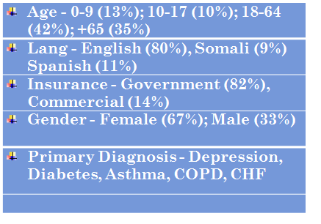
Baseline Snapshot: July 2013-166 Patients

Slide 9
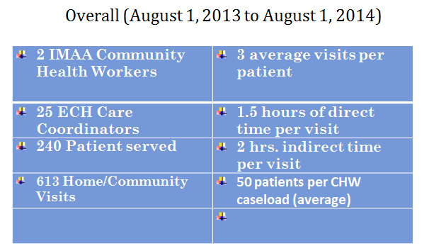
What Are We Doing ?

Slide 10
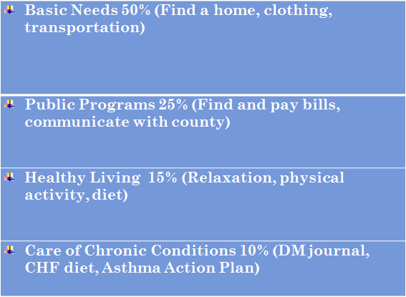
Direct Care Support Themes: Co-Evaluation through Chart Review

Slide 11
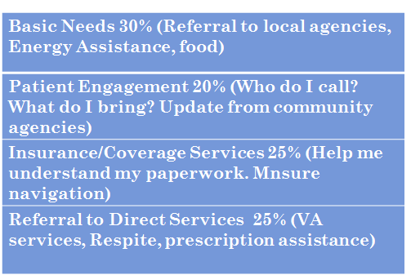
Non Visit Care Support Needs

Slide 12
Lead Patient Education Tools
PHQ-9
Asthma Control Test
Asthma Control Assessment
Asthma Action Plan
Peds Quality of Life Form
Goal Setting
Goal Map
Journaling
Log books (BP, Diabetes, Activity)

Slide 13
Satisfaction and Assurance Data
Patients, Care Coordinators and CHW satisfaction data collected using surveys
Integration of patient stories/cultural narratives
Review of lead reporting tool: CHW Visit Form
Monthly case consultation with CHWs & ECH teams; ongoing specialized training
Co-Supervisory meetings with IMAA
MN CHW Alliance & MN CHW Alliance Supervisor Roundtable participation

Slide 14
Lessons Learned: Holistic Relational Care
Home visits are critical in understanding patient/family experiences, strengths, needs, and health determinants
Use of one’s language, literacy, and culture remain significant factors within care, healing, and health outcomes
Mixed methods analysis in partnership with the CHW team is important when reviewing, reporting and analyzing patient data
Community based CHW services are essential in the integration of community contexts and team based care within value-based contracting and blended funding.

Slide 15
Next Steps
Continue expansion in ECH-Rochester site
Explore collaboration options for expansion of the CHW role to other Mayo Health System sites
Maintain discussion with Payer Relations
Continue to work with the Mayo Clinic Center for the Science of Health Care Delivery on determining quality cost outcomes for CHW programming
Continue to work with the practice leadership on maintaining and securing long-term operational and shared-risk savings funding for CHW services

